Slide 2
Equations

Slide 3
n_H = H/300
n_Q = Q/300
n_M = M/300
n_R = R/7459
#Cell density (protein conc)in uM
#Cell volume in L
all_prot = Q +R +M +H
Vcell = (all_prot*1e6/6e23)/Dcell
P_conc = P/all_prot
#Uptake
#Need to convert OD to cells
#Convert from OD to umol: *1.667e-7
#Convert from molecs to umol: /6e17
uM_cells = x*1.667e-6
t_frac = t_frac_min + dt_frac*k_t_frac**ntf/(P_conc**ntf + k_t_frac**ntf)
n_T = n_M*t_frac
uptake = v_uptake*n_T*S/(S + k_uptake)
total_uptake = uptake*uM_cells
#Translation
#Need to convert from molecs to umol
r_sat = P_conc/(P_conc + k_synprot)
r_inh = k_cm/(Cm + k_cm)
synprot = v_synprot*n_R*r_sat*r_inh
#R feedback
PR = P/R
reg = PR**n_fr/(k_fr**n_fr + PR**n_fr) *(1-0.046) + 0.046
fr_ = fr*reg
; fr_ = np.maximum(fr*reg, 0.046)
#Induction
fh_ = fh*ind/(k_ind + ind)
#Split pools
synp = uptake*yield_S
synQ = synprot*fq
synM = synprot*(1-fq)*fm /(fm + fr_ + fh_)
synR = synprot*(1-fq)*fr_/(fm + fr_ + fh_)
synH = synprot*(1-fq)*fh_/(fm + fr_ + fh_)
#Growth rate
mu = (synQ +synM +synR)/Mcell
dS = -dil*S +dil*Sin -total_uptake
dx = -dil*x +x*mu
dP = -mu*P +synp -synprot
dQ = -mu*Q +synQ
dR = -mu*R +synR
dM = -mu*M +synM
dH = -mu*H +synH

Slide 4
Assumptions

Slide 5
Converting between biomass and OD
Assume constant amount of protein per cell
Assume constant number of cells per OD

Slide 6
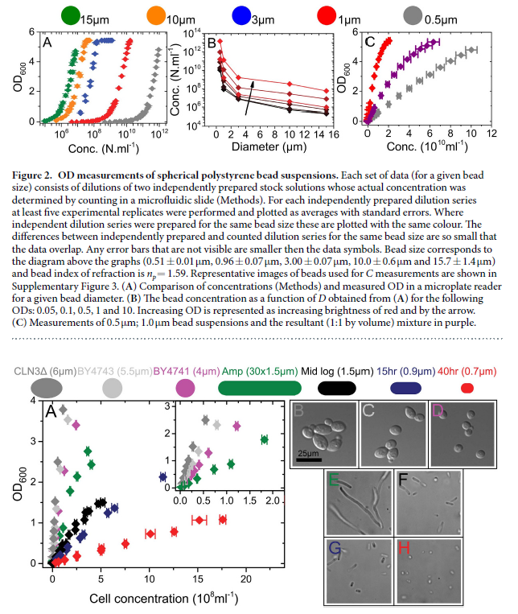
Assume constant number of cells per OD
Light scattering is size dependent but the variation is small if kept within a certain range
E. coli cells that are still growing are between 0.9~1.5um
1 OD taken to be 500 million to 1.2 billion cells per mL
Does not apply to cells with length 0.7um in the stationary phase

Slide 7
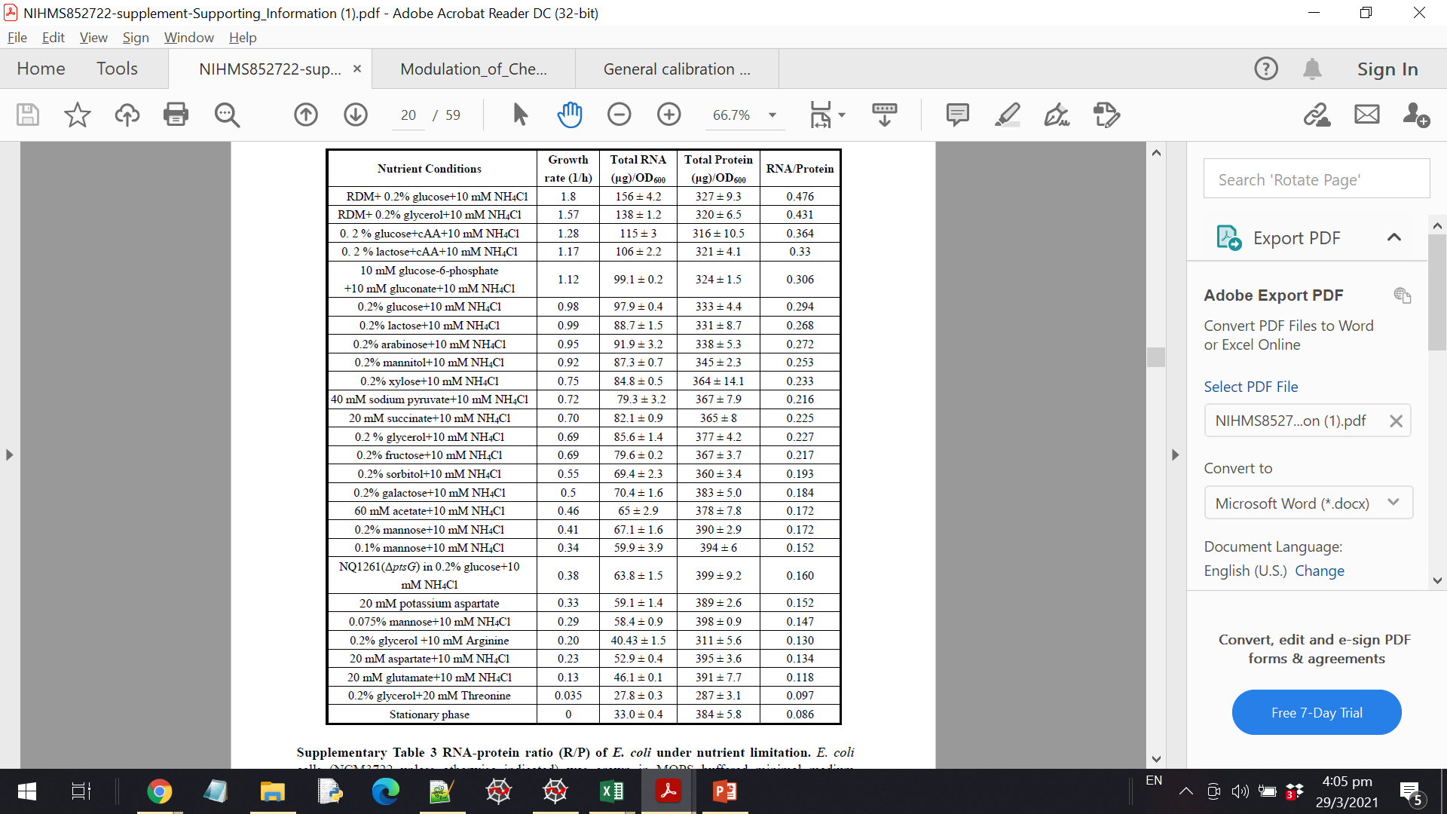
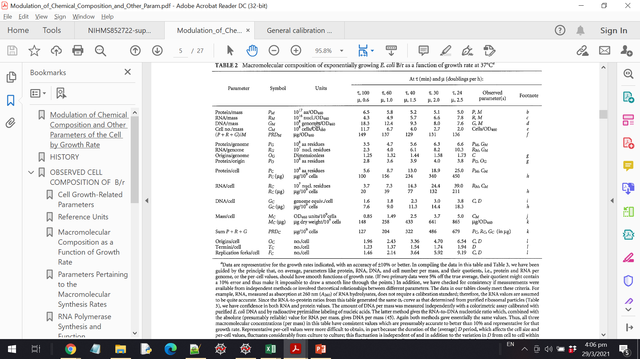
Assume constant amount of protein per cell
Not necessarily true but apparently depends on the strain
Some researchers have proposed the concept of a “unit” of cell size but it has not been used in resource-related studies

Slide 8
Curve Fitting

Slide 9
Free Parameters
Substrate uptake: v_uptake, k_uptake
Proportion of M pool involved in transport: t_frac_min, dt_frac, k_t_frac
Protein synthesis: k_synprot
R pool feedback: k_fr

Slide 10
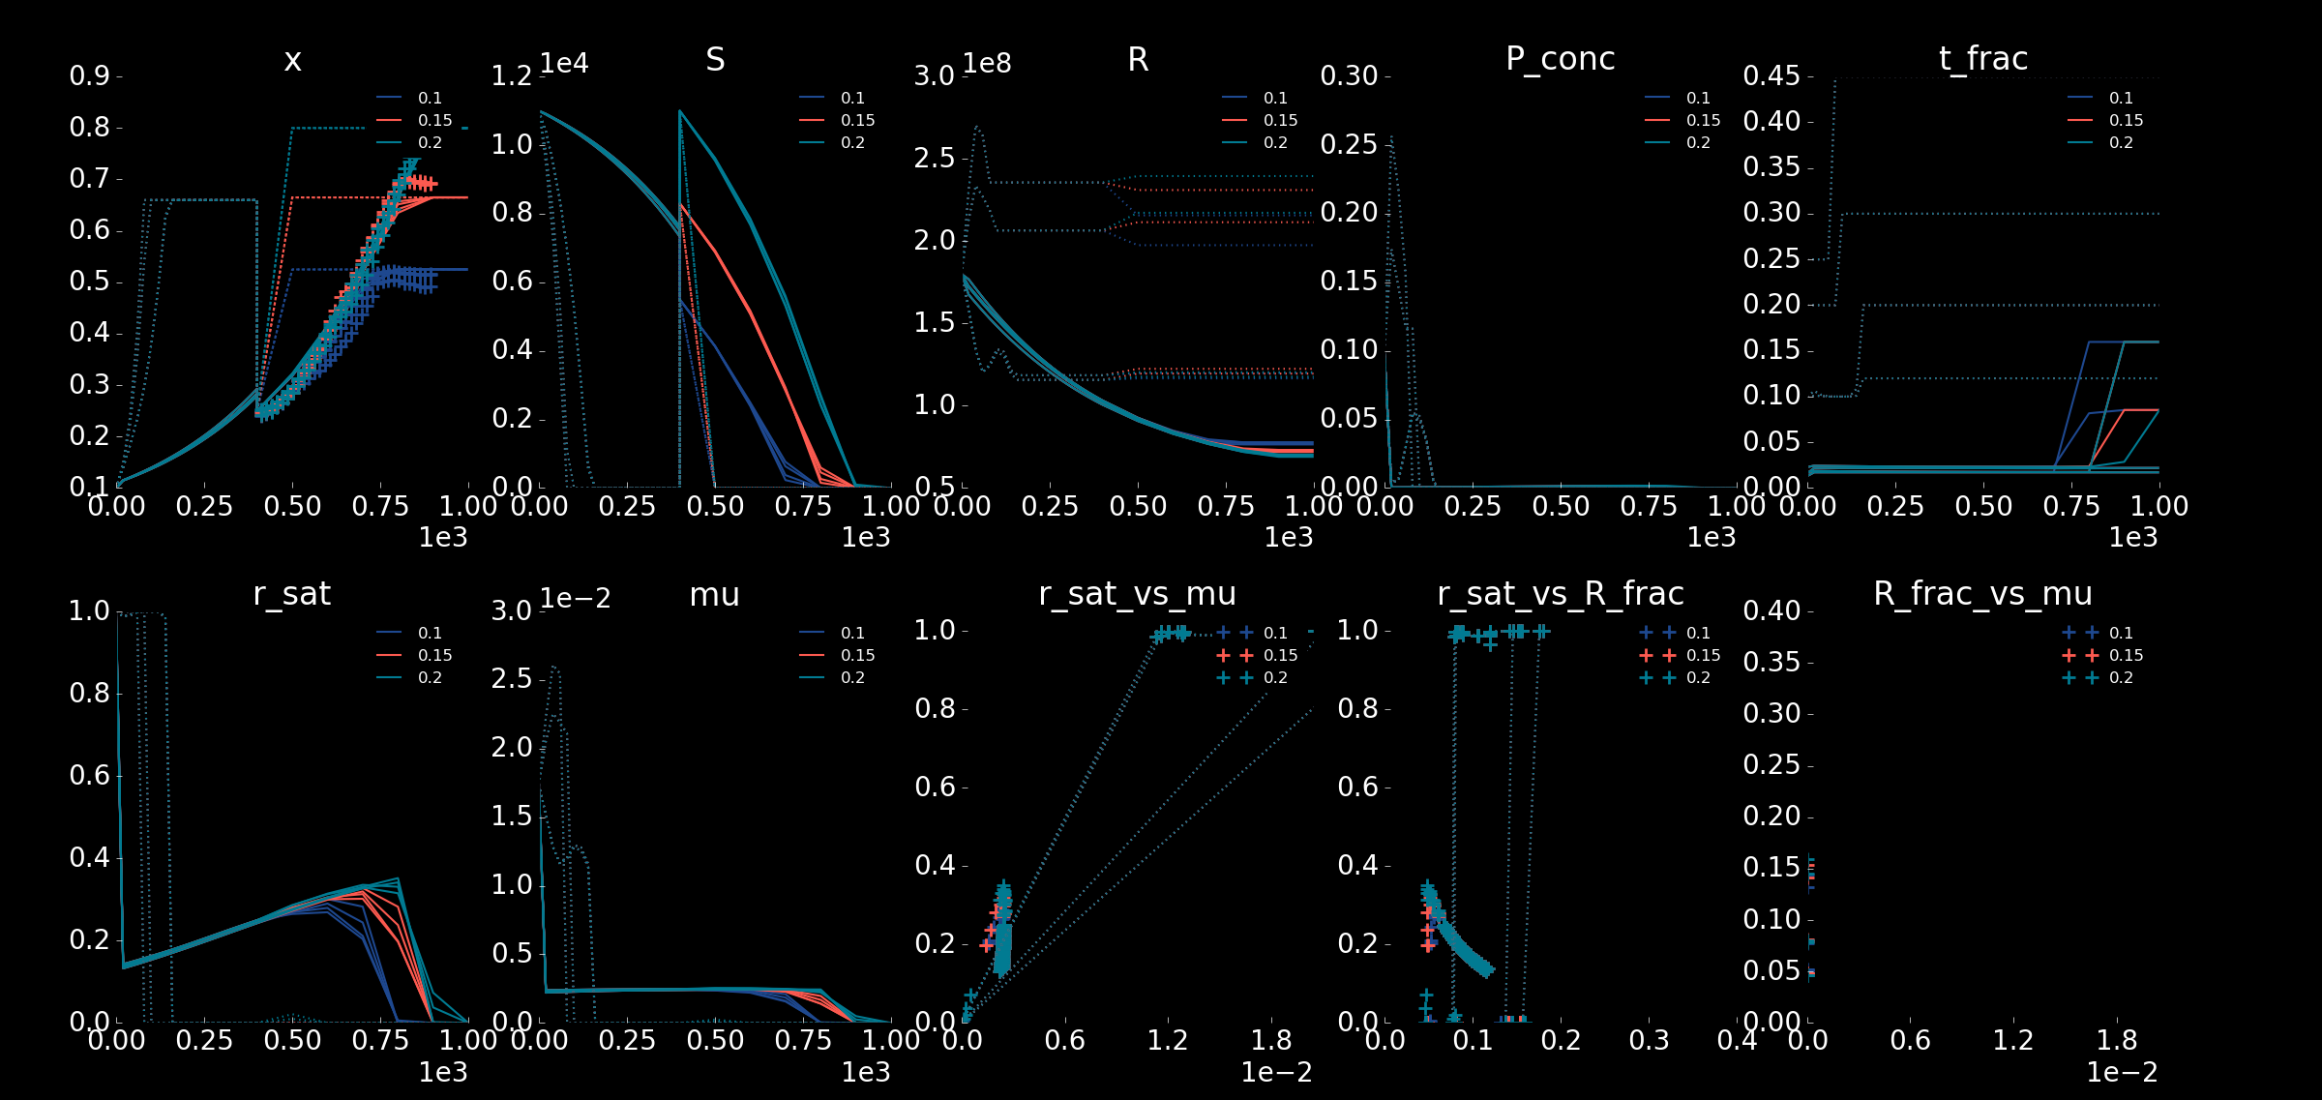

Slide 11
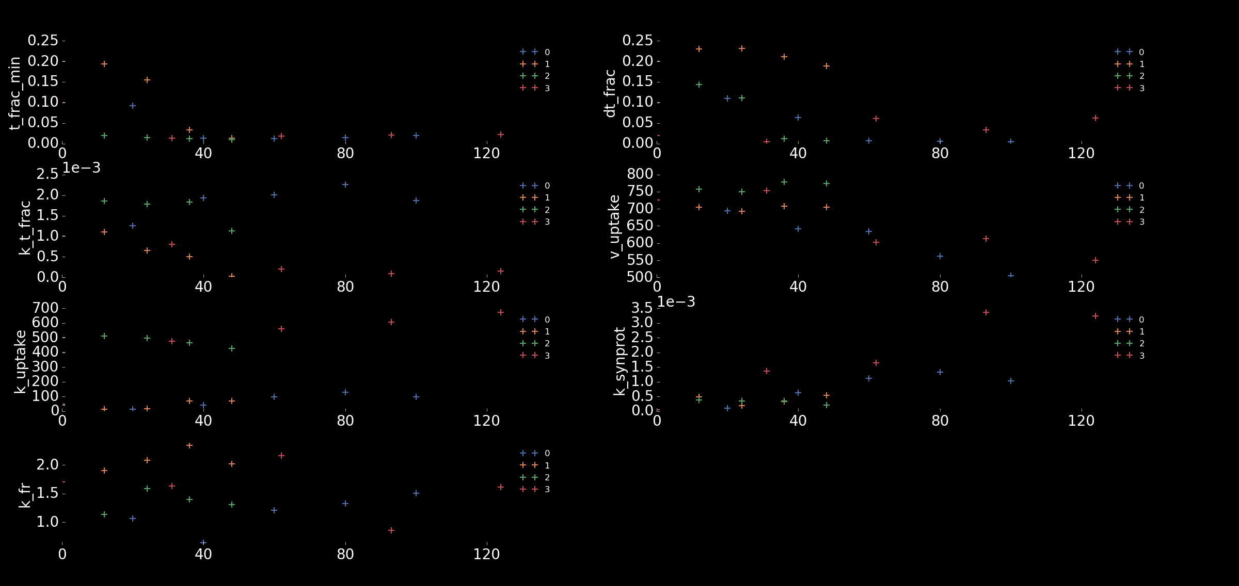

Slide 12
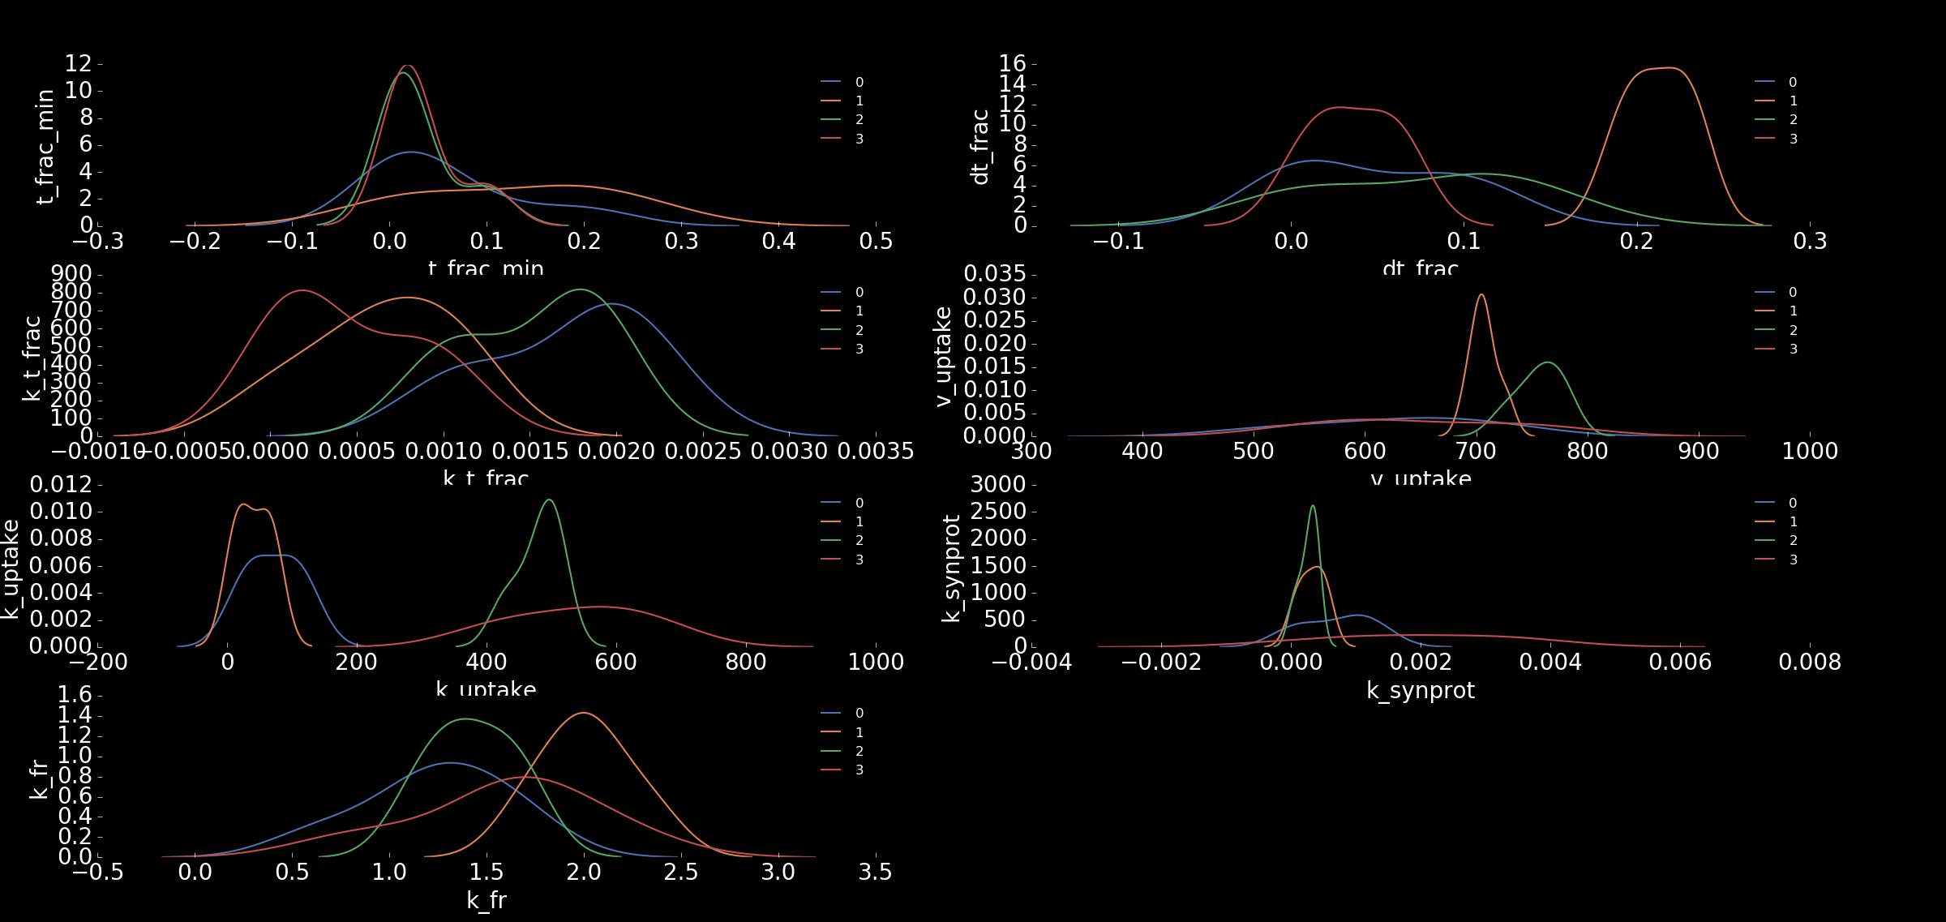

Slide 13
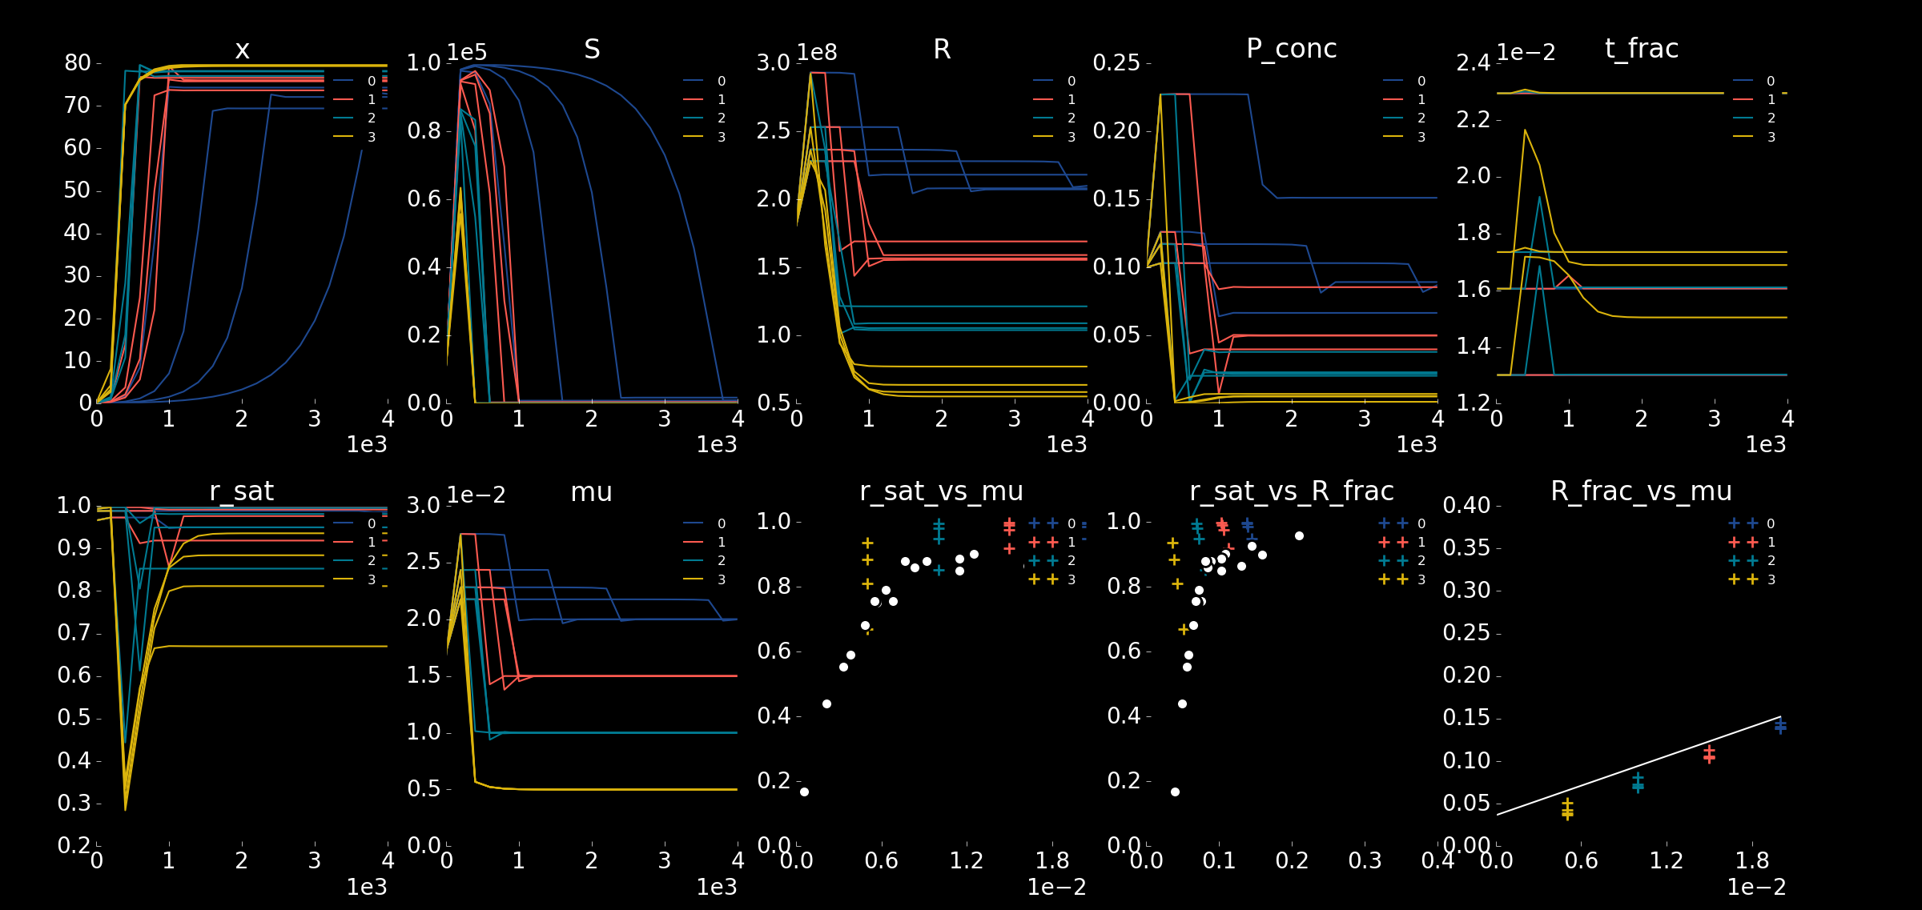

Slide 14
Source for E. coli Physiological Parameters

Slide 15
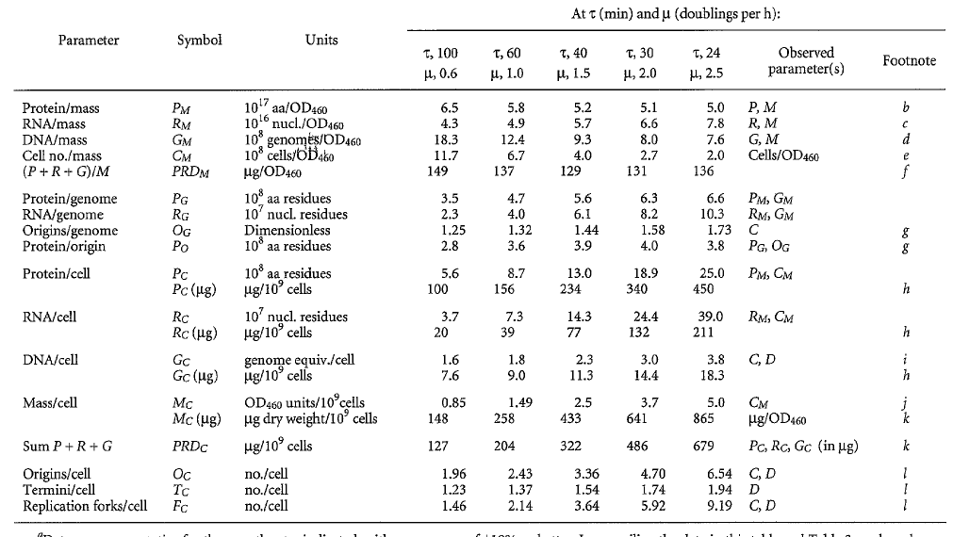

Slide 16
Source for Model Data
Dai, Xiongfeng, et al. "Reduction of translating ribosomes enables Escherichia coli to maintain elongation rates during slow growth." Nature microbiology 2.2 (2016): 1-9.

Slide 17
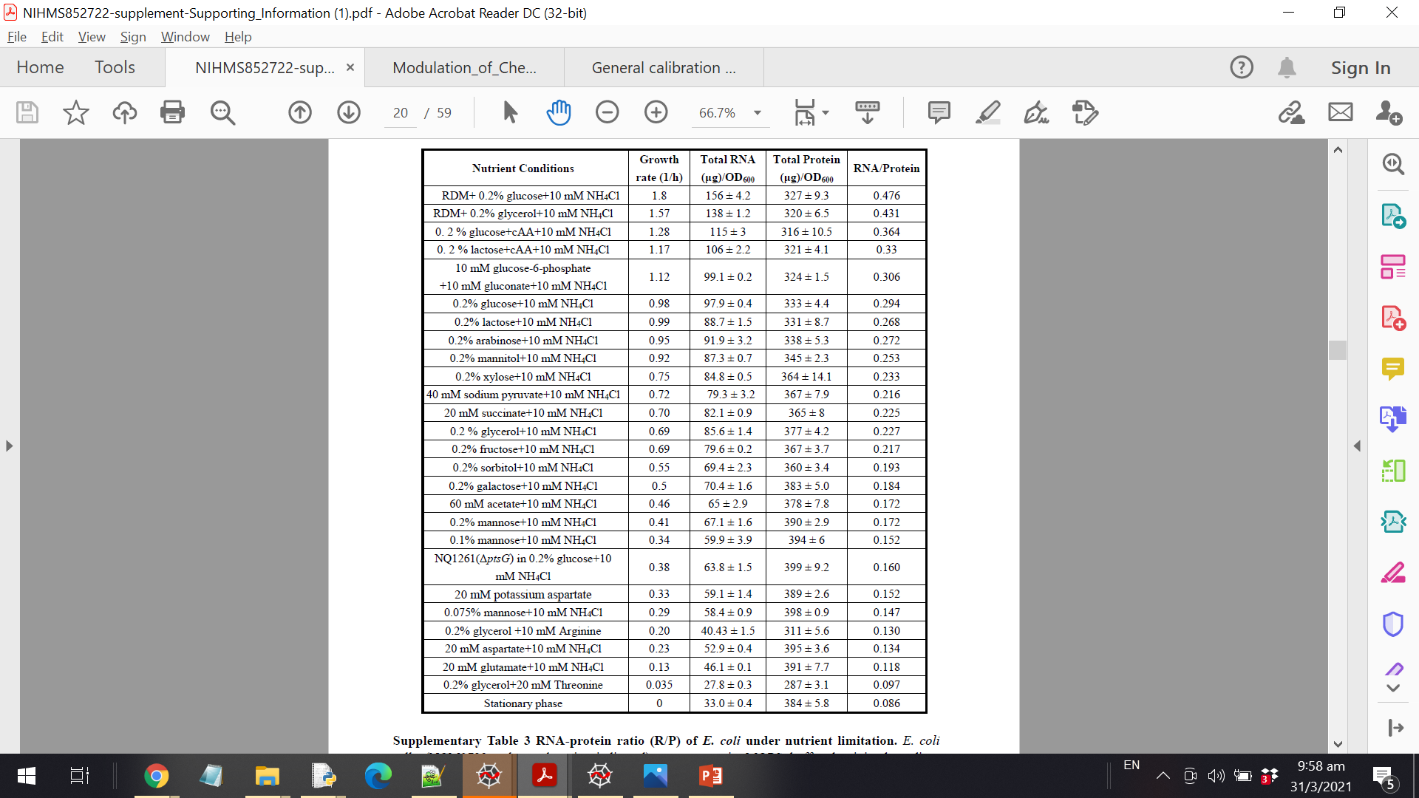

Slide 18
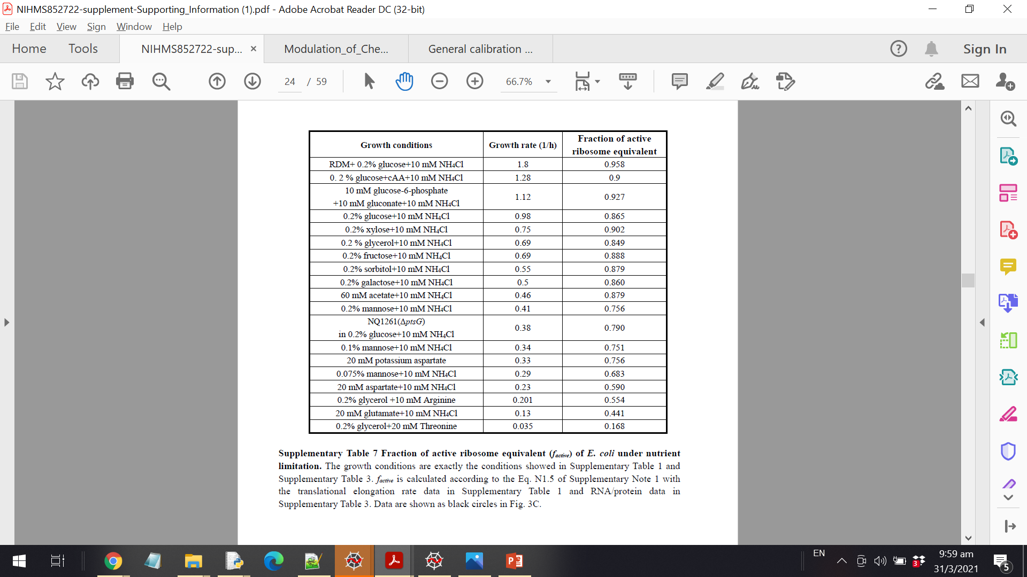

Slide 19
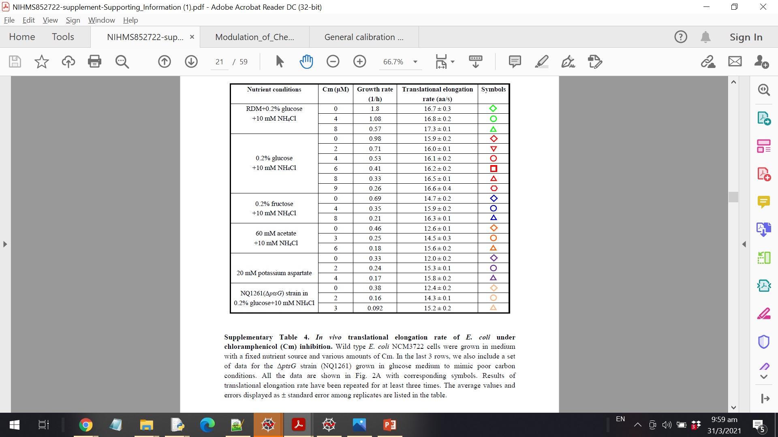

Slide 20
Curve-Fitting with Synthetic Data

Slide 21
Observations
Current fit could not be improved

Slide 22
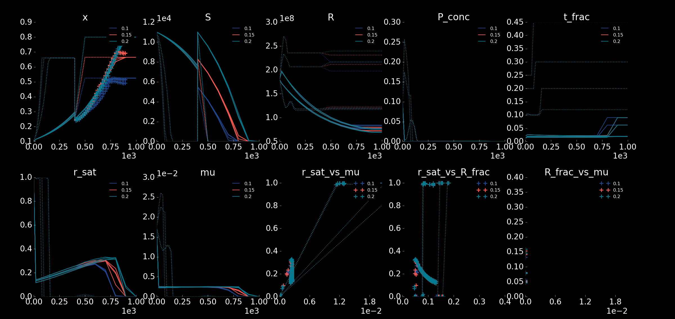

Slide 23
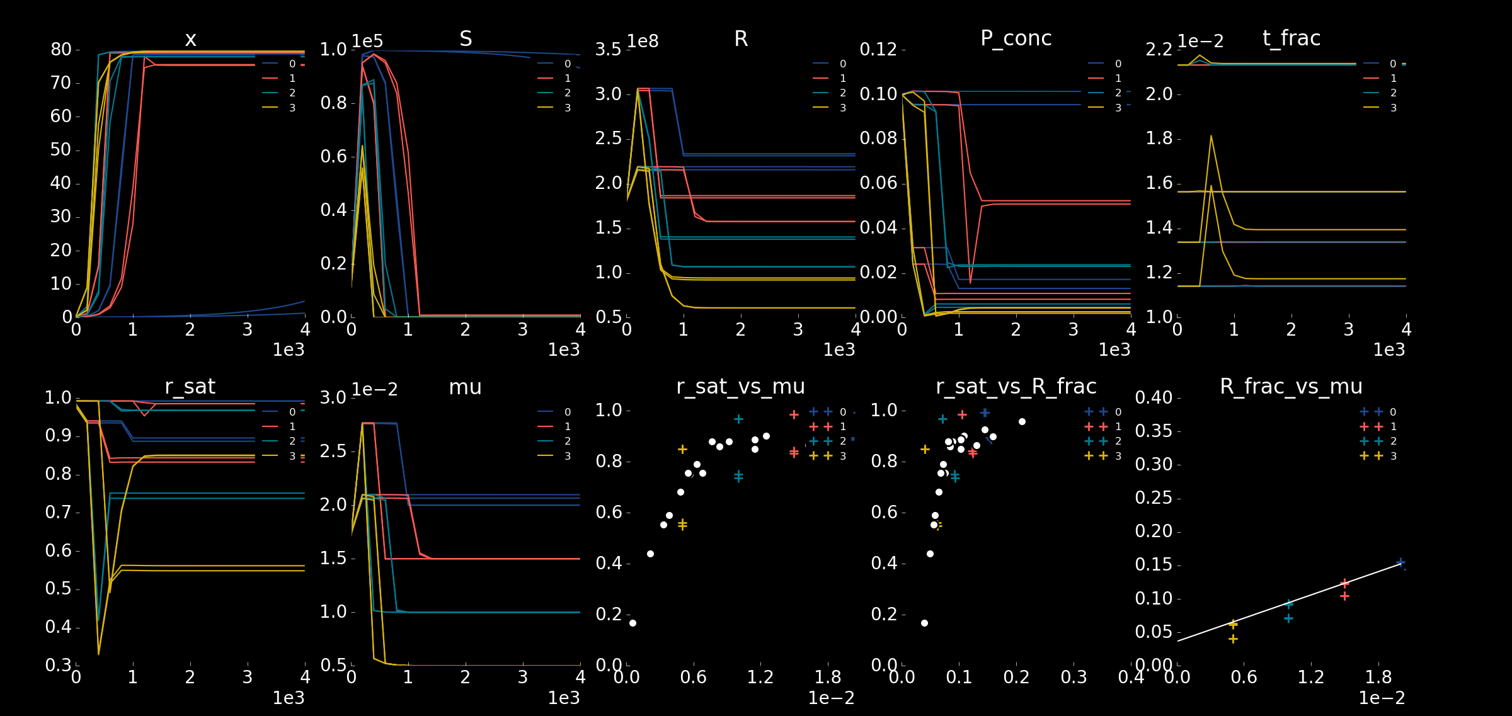

Slide 24
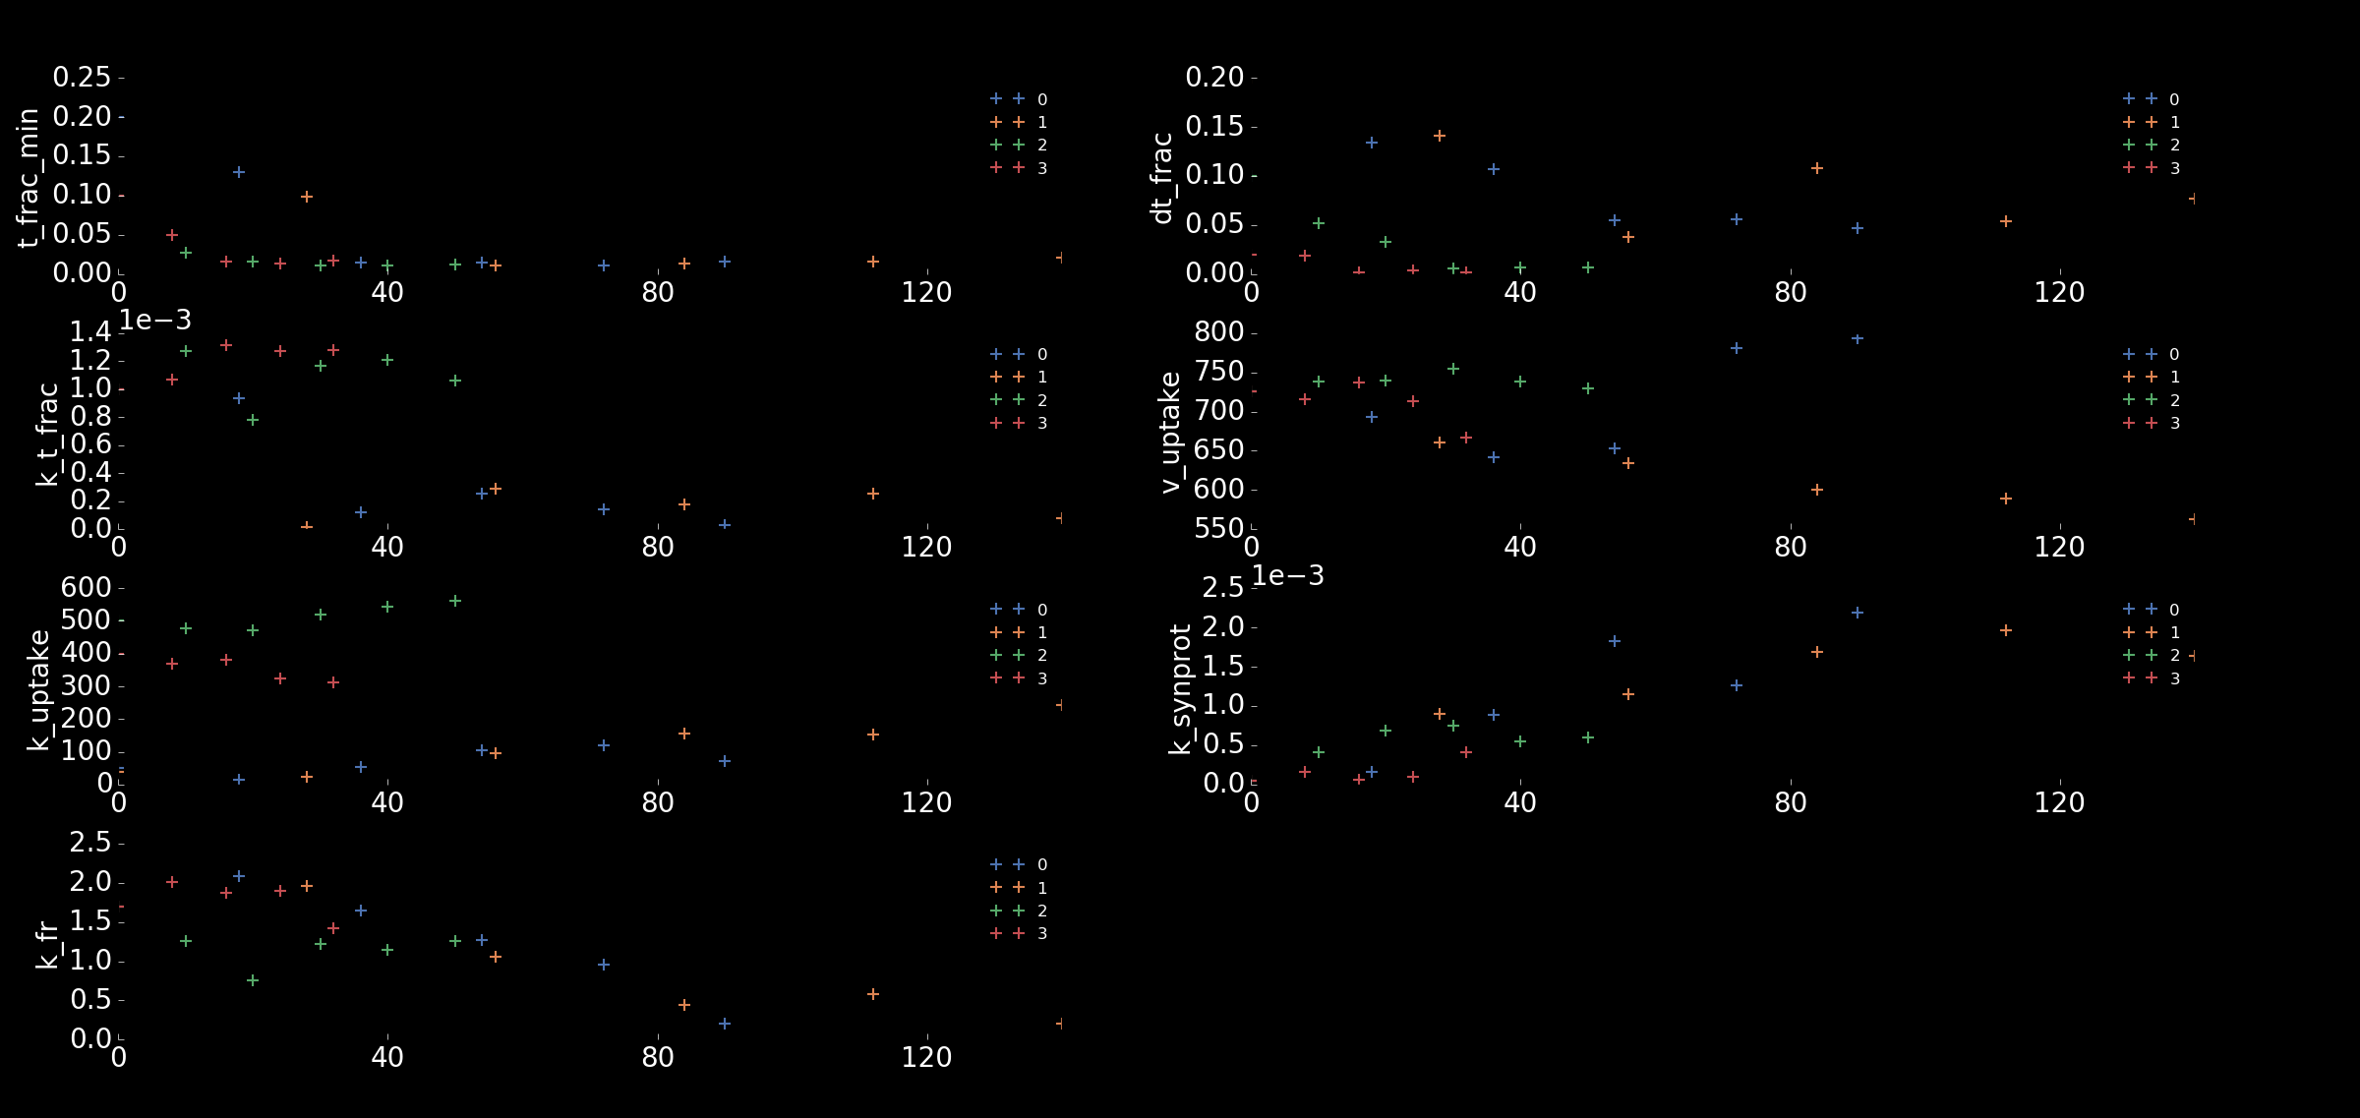

Slide 25
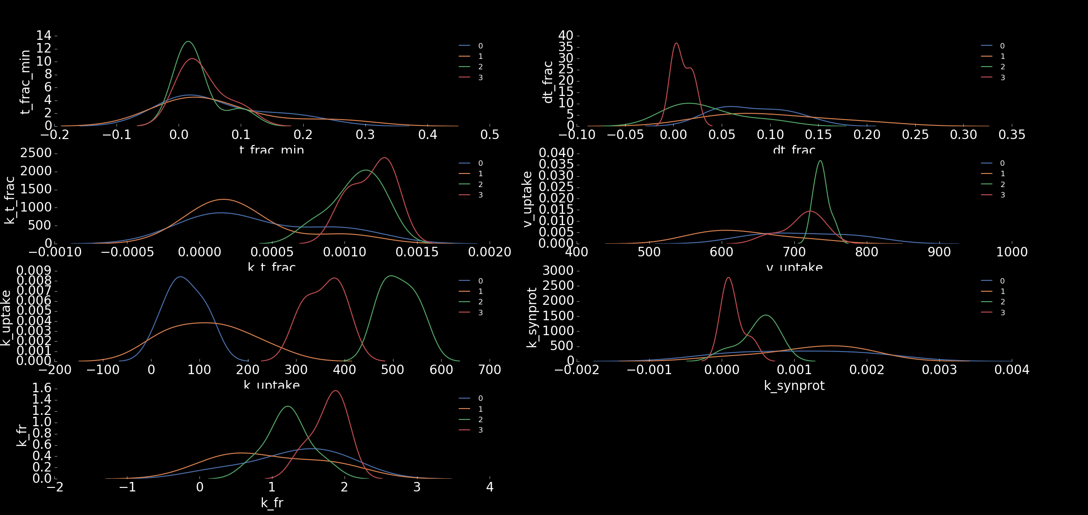

Slide 26
Increasing free parameters
Fm is now a free parameter

Slide 31
v_uptake | Maximum substrate uptake rate
k_uptake | MM constant for uptake
t_frac_min | Minimum transporter fraction
dt_frac | Maximum increase in transporter fraction
k_t_frac | MM constant for transporter regulation
k_synprot | MM constant for translation
k_fr | MM constant for ribosome regulation
fm | Scaling factor for M synthesis
fq | Scaling factor for Q synthesis
 | Free | Identifiable
Without | 7 | 2
With | 7 | 3
Without | 8 | 1
With | 8 | 1
Without | 8 | 1
With | 8 | 2
Without | 9 | 0
With | 9 | 1

Slide 34
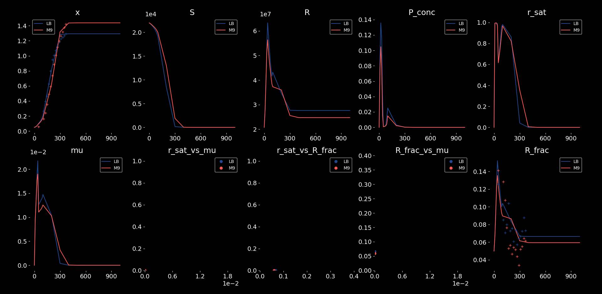

Slide 35
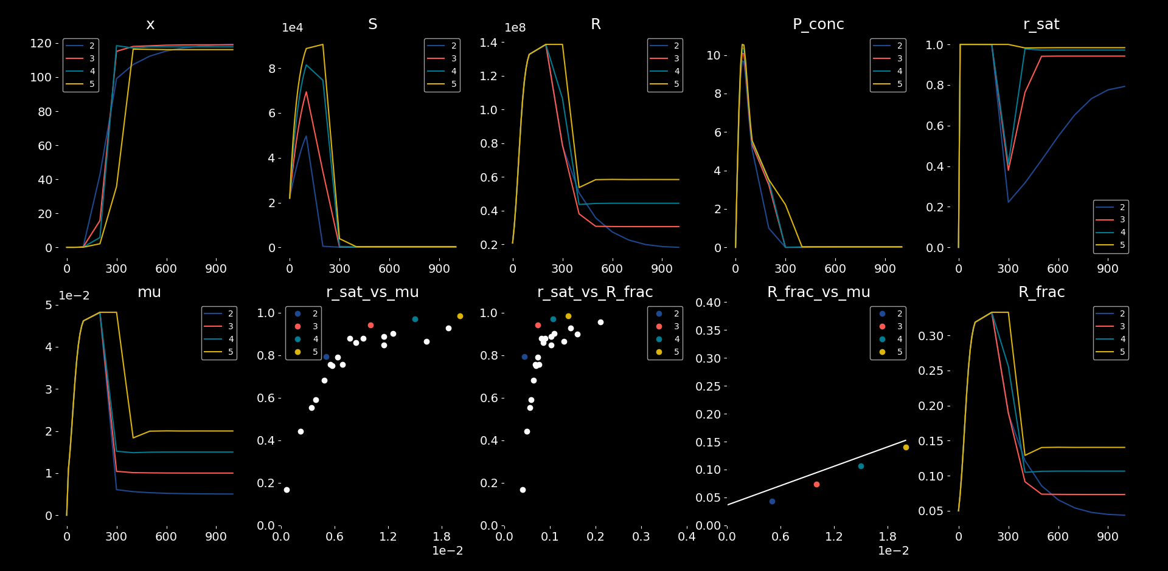

Slide 36
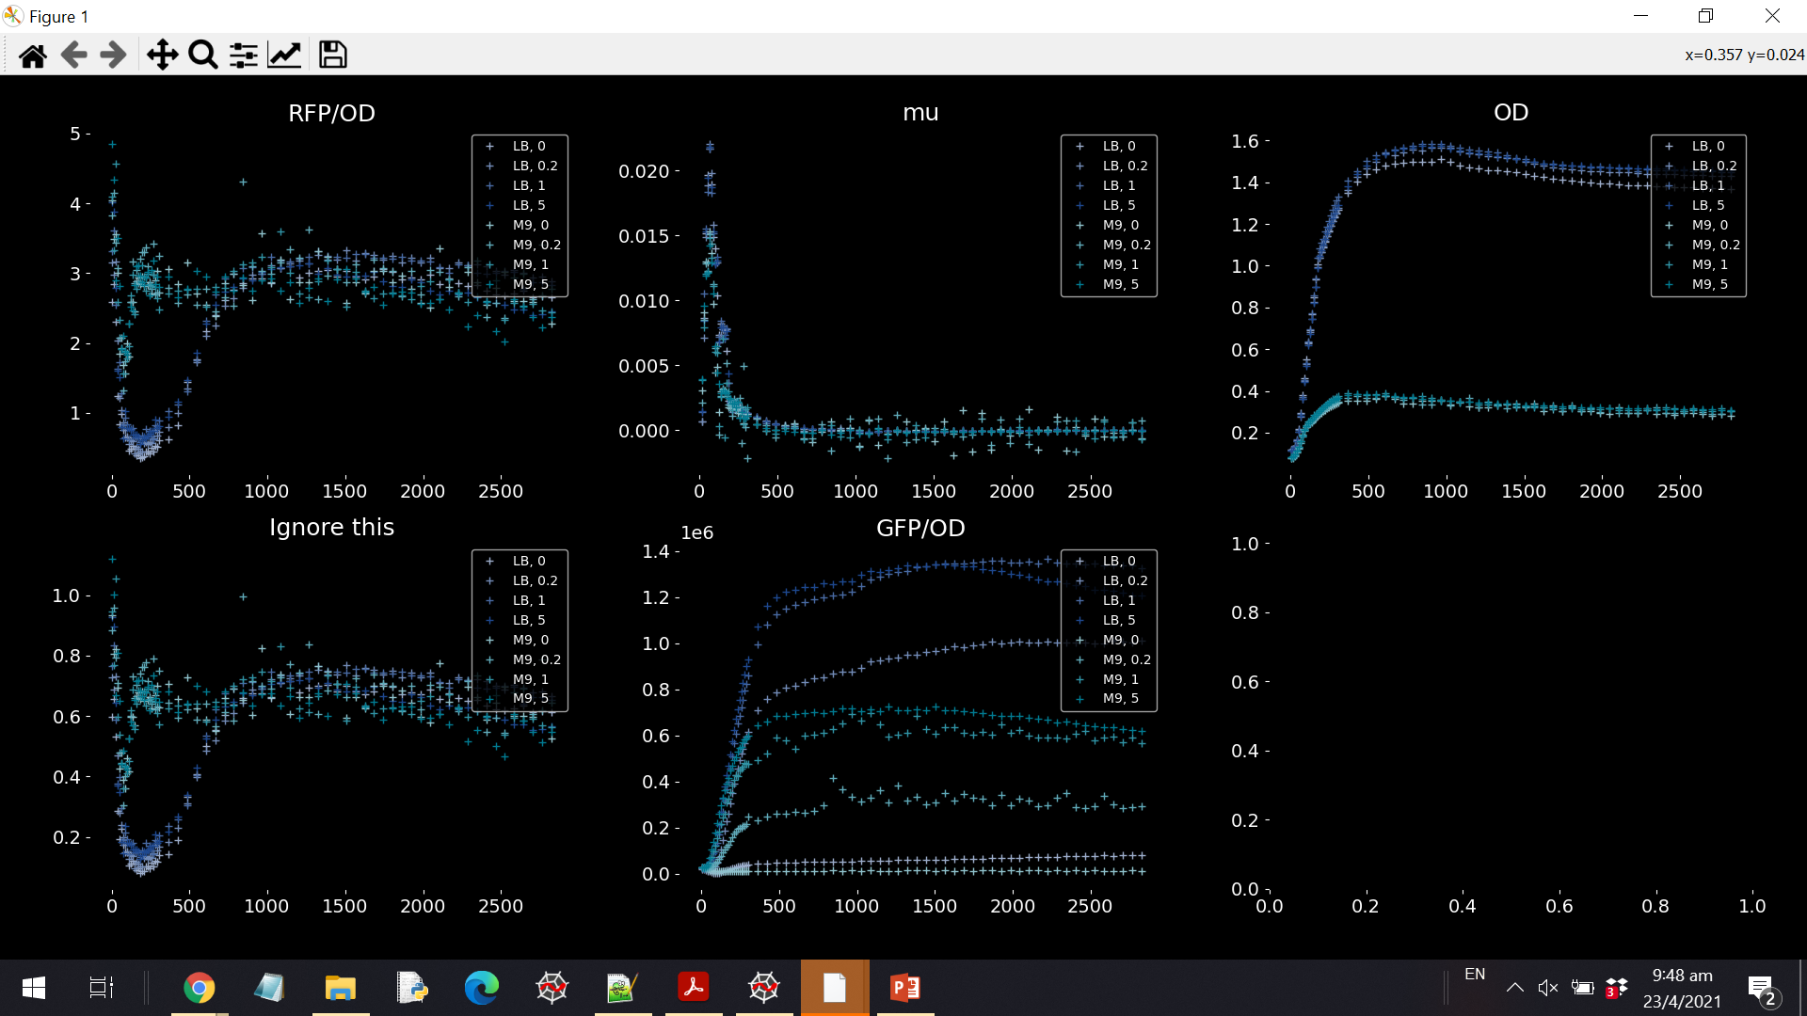

Slide 37
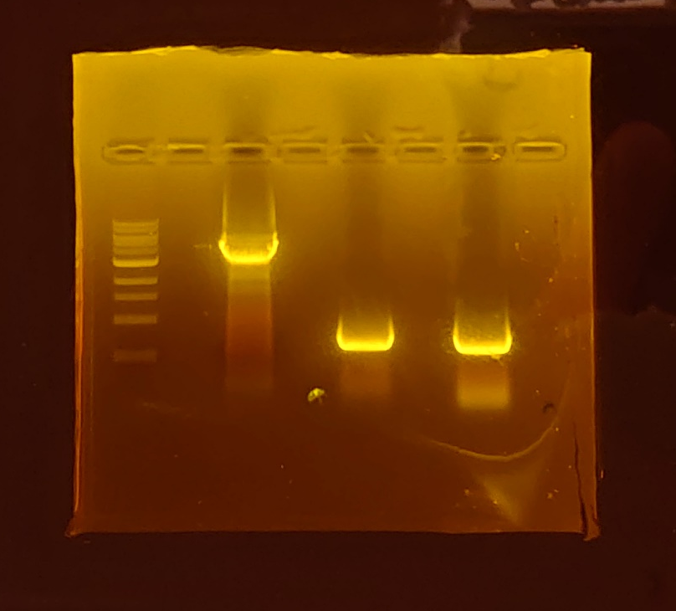

Slide 38
OT2
Partial instead of full combinatorial assembly

Slide 39
96 Well

Slide 40
Overview
Plasmid p1 contained inducible (IPTG) GFP
Plasmid p2 contained constitutive and inducible (IPTG) GFP
Expected p2 to show a lower growth rate or higher R fraction for same growth rate

